Slide 1
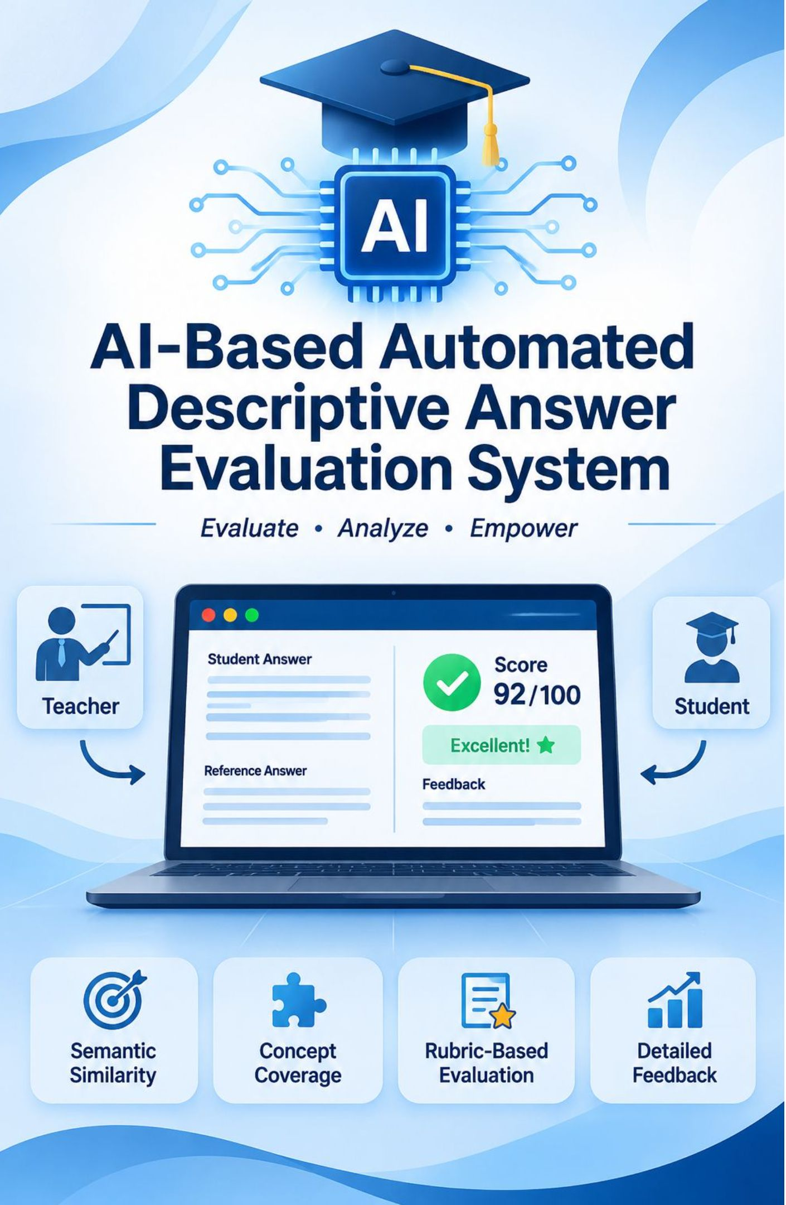
AI-BASED AUTOMATED DESCRIPTIVE ANSWER EVALUATION SYSTEM
Submitted by
Syed Abdur Rahman Bokhari-160923733183
Abdul samad-160923733194
Safwan Ahmed-160923733212
Mirza Affanullah Baig - 160923733215
Department of Computer Science Engineering
Lords Institute of Engineering and Technology
Affiliated to Osmania University, Hyderabad
Academic Year: 2026–2027
Guide: [Ms.Rizwana Khatoon]

Slide 2


Proposed platform
PROJECT OVERVIEW
Teachers define the standard
Reference answers, expected concepts and rubrics establish the assessment criteria.
Students submit answers
The platform receives descriptive responses for question-specific evaluation.
AI supports evaluation
Meaning-based assessment proposes marks and concept-level feedback under teacher supervision.
Teacher-supervised assessment

Slide 3
Why this project
PROBLEM STATEMENT
Manual effort
Evaluator variation
Shallow feedback
Reading and scoring every descriptive answer takes substantial teacher time.
Interpretation and marking can differ across evaluators and assessment sessions.
Keyword matching misses paraphrases and meaning; marks alone do not explain conceptual gaps.
The need is supervised conceptual assessment with transparent feedback.

Slide 4
Research foundations
LITERATURE SURVEY
Study | Focus | Relevance to the proposal
Haller et al. (2022) | Deep learning grading survey | Frames automated grading approaches and evaluation challenges.
Brown et al. (2020) | Few-shot learning | Motivates using examples to guide language-model behaviour.
Lewis et al. (2020) | Retrieval-augmented generation | Supports grounding evaluation in supplied reference material.
Kortemeyer (2024) | GPT-4 grading | Informs investigation of LLM-assisted assessment.
Metzler, Plöger and Hees (2024) | LLM grading with rubrics | Highlights rubric guidance and inconsistency risks.
Design implication: ground scoring in teacher criteria and retain human review

Slide 5
Proposed workflow
PROPOSED SYSTEM
01
02
03
Configure
Submit
Analyse
Teachers provide references, concepts, maximum marks and rubrics.
Students submit descriptive answers for the selected question.
Semantic analysis, concept coverage and rubric scoring generate a proposed result.

Slide 6
Proposed four-layer design
SYSTEM ARCHITECTURE
Presentation portals
Teacher/admin portal ↔ Student portal
Application APIs · Java 21 and Spring Boot
Authentication, submissions, evaluation orchestration and result delivery
AI/NLP engine · Python
Semantic analysis → Concept coverage → Rubric scoring → Confidence
Data storage · PostgreSQL or MySQL
Questions, references, submissions, results and audit history
Requests flow through the APIs to evaluation and storage; results return through the APIs to users.

Slide 7
Responsibilities and control
MAIN MODULES
Teacher/admin
Student
AI evaluation
Manage questions, reference answers, concepts, rubrics and access.
Submit responses and view marks with concept-level feedback.
Compute scoring components and identify uncertain assessments.
Analytics
Human review
Summarise performance and recurring concept gaps.
Teachers can modify marks; an audit history records changes and review decisions.

Slide 8
Configurable scoring model
SCORING METHODOLOGY
S · Semantic similarity
K · Concept coverage
R · Rubric score
Meaning alignment between the student response and reference answer.
Coverage of teacher-defined expected concepts.
Normalised assessment against question-specific rubric criteria.
Weights are configurable, not fixed. Components should use a common normalised scale; component agreement informs confidence and teacher review.

Slide 9
Proposed options, subject to selection
TECHNOLOGIES USED
Layer | Technology options | Purpose
Frontend | React.js or Angular | User portals
Application | Java 21, Spring Boot | APIs and orchestration
AI/NLP | Python, Transformers, spaCy and SBERT | Text and meaning analysis
Language model | OpenAI, Azure OpenAI or local LLM | Rubric-based assessment
Storage / retrieval | PostgreSQL or MySQL; pgvector or Qdrant | Records and vectors
Security | Spring Security, JWT, OAuth2 | Access control
Documents / deployment | Tika or PDFBox; Docker and cloud deployment | Extraction and hosting

Slide 10
Possible extensions
FUTURE SCOPE AND CONCLUSION
OCR for handwritten answers
Multilingual and multimodal evaluation
Plagiarism detection and institution-specific tuning
Fairness evaluation and adaptive learning recommendations
Project goals
Teacher-supervised, consistent evaluation with concept-level feedback. These remain proposed outcomes requiring validation.

